Slide 1
MENTORNESS INTERNSHIP PROGRAM
Project 2
Task 3
Batch Name: MIP-ML-08
Project Name: World Cup 2023 Data Analysis By Md. Harun-Or-Rashid Khan
Problem Statement:
Tasked with performing a detailed exploratory data analysis on the World Cup 2023 dataset.
The goal is to uncover patterns, trends, and notable statistics that provide a delicate understanding of team and player performance.
Problem Type:
Data Analysis Project with Python.

Slide 2
Description of each column in the dataset:
team: The cricket team to which the player belongs.
player: The name of the cricket player.
bat_or_bowl: Indicates whether the player batted or bowled in the innings. It could have values like 'bat' for batting and 'bowl' for bowling.
bb_bf: The total number of balls bowled or faced by the player.
runs: The total runs scored by the player in the innings.
wkts: The total wickets taken by the player in the innings.
wicketball_prob: Probability of taking a wicket per ball bowled.
runs_per_ball: Average runs scored by the player per ball faced or bowled.
opposition: The opposing team against which the player played the match.
ground: The cricket ground where the match was played.
start_date: The date when the match started.
overs: The total number of overs bowled by the player.
mdns: The number of maidens bowled by the player.
econ: The economy rate of the player (runs conceded per over bowled).
inns: The innings number of the player (e.g., 1st innings, 2nd innings).
4s: The number of fours hit by the player.
6s: The number of sixes hit by the player.
sr: The strike rate of the player (runs scored per 100 balls faced).
not_out: Indicates whether the player remained not out in the innings.
mins: The number of minutes the player spent on the field during the innings.

Slide 3
Mission:
I will follow these key steps:
Data Preprocessing:
Ensure data is cleaned and formatted properly.
Handle missing values and outliers if necessary.
Prepare the dataset for analysis.
Exploratory Data Analysis (EDA) - Batsman:
Analyze batting performance metrics such as runs scored, strike rate, boundaries, etc.
Identify top-performing batsmen based on key metrics.
Visualize batting performance trends and patterns.
Exploratory Data Analysis (EDA) - Bowlers:
Analyze bowling performance metrics such as wickets taken, economy rate, maidens bowled, etc.
Identify top-performing bowlers based on key metrics.
Visualize bowling performance trends and patterns.
Conclusion:
Summarize key findings from the EDA of batsmen and bowlers.
Provide insights into team performances, player contributions, and overall tournament dynamics.
Offer recommendations or areas for further analysis if applicable.
This mission will provide a comprehensive analysis of the dataset, offering insights into the performances of both batsmen and bowlers in cricket matches

Slide 4
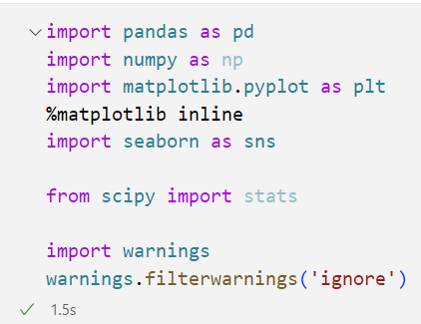
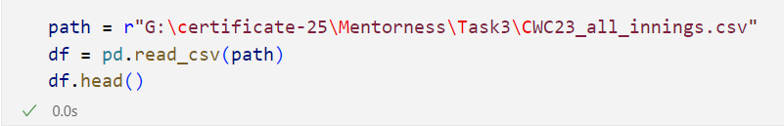
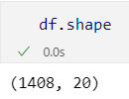
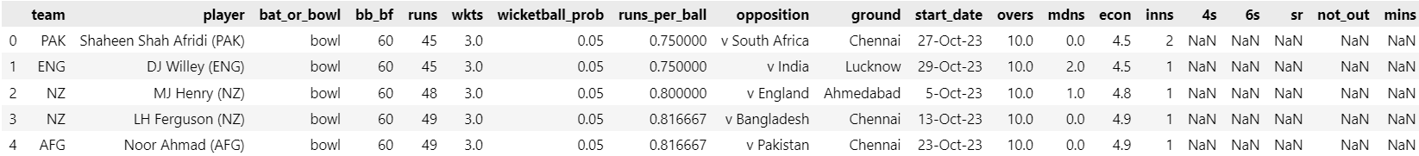
Data Reading

Slide 5

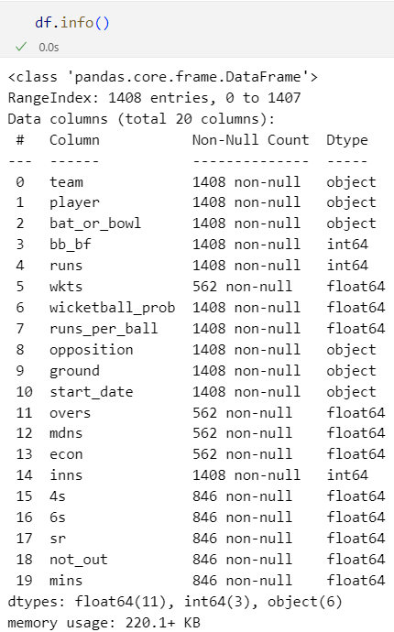
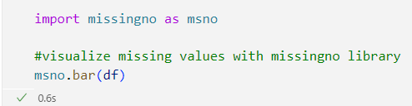
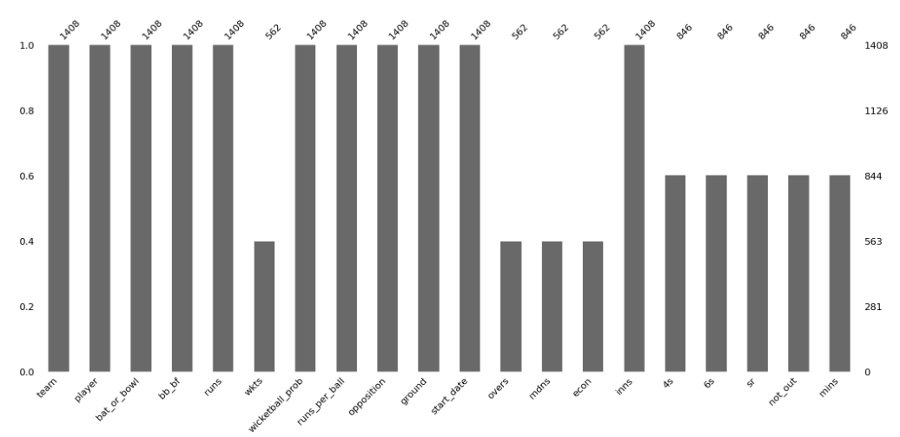

Slide 6
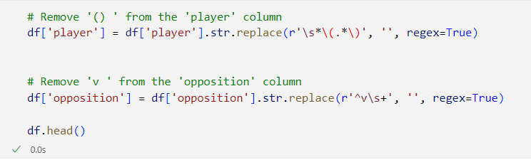
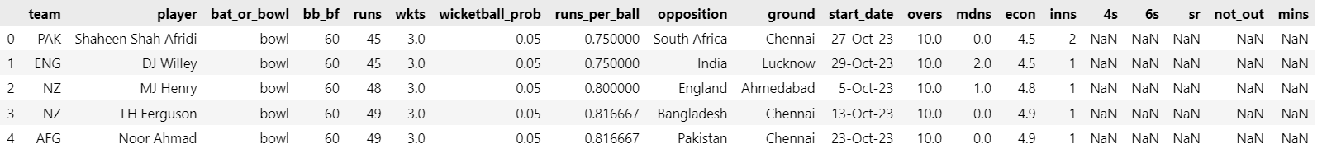
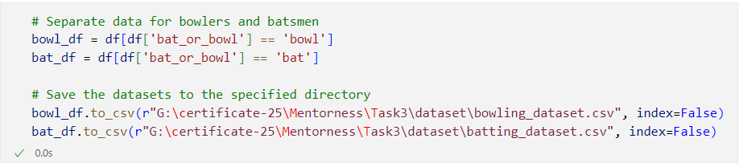
Batting Part

Slide 7

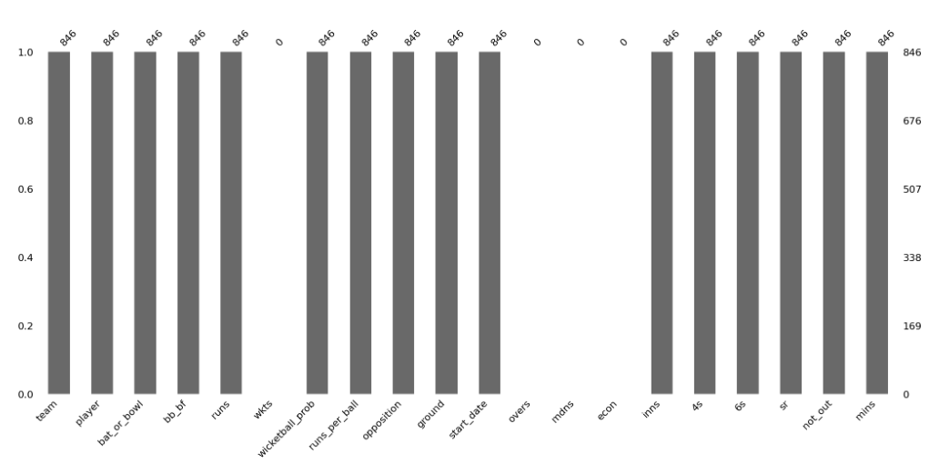


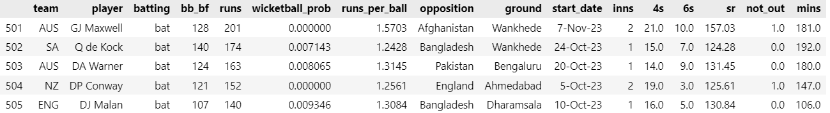

Slide 8
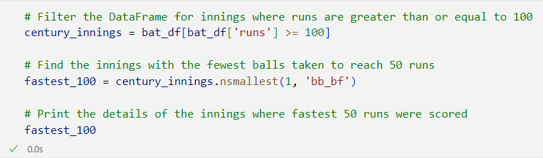
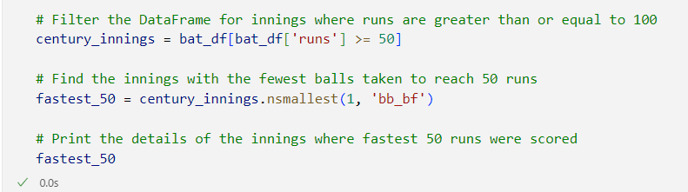
Fastest
100 & 50

Slide 9
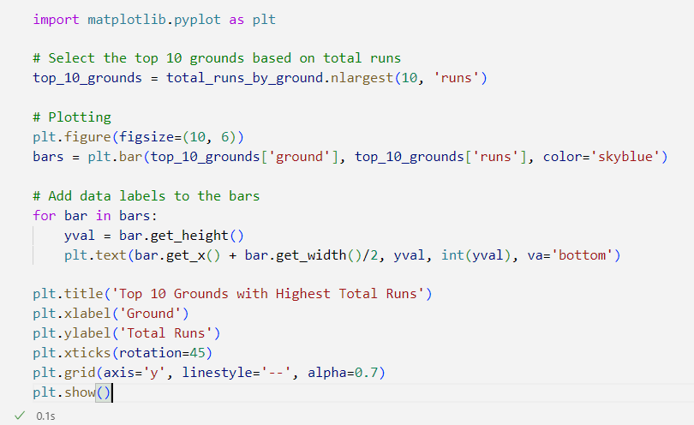

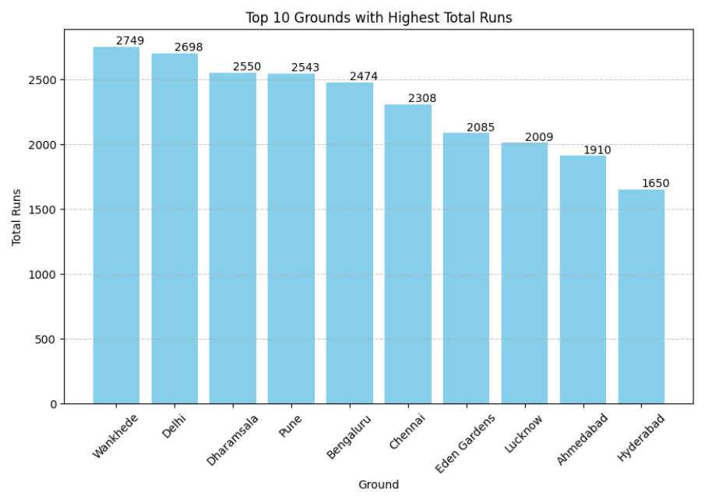

Top 10 Grounds

Slide 10
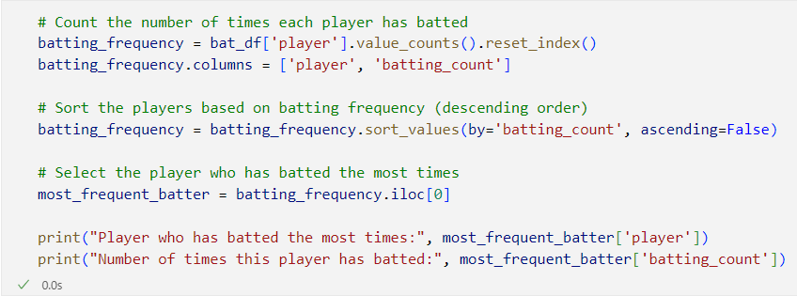

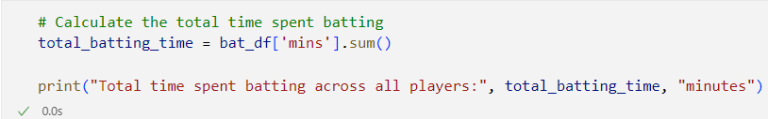

Slide 11
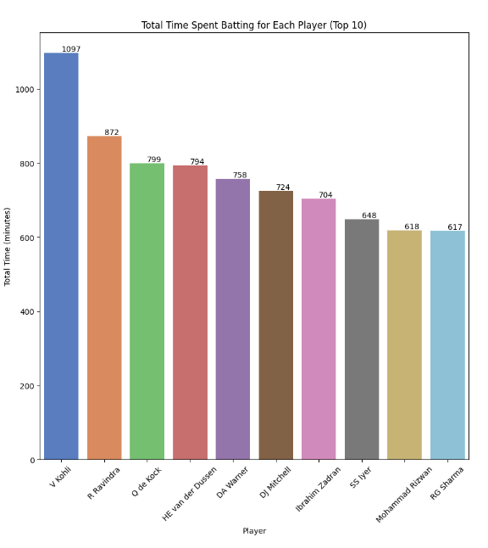
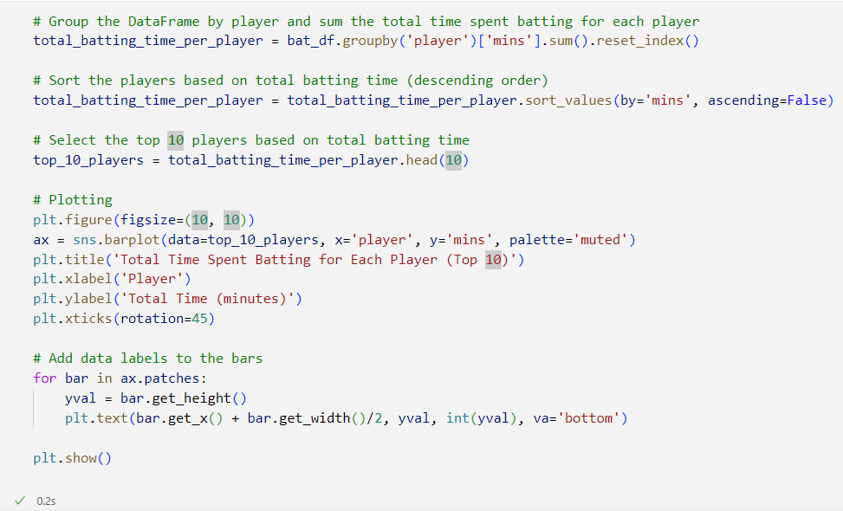
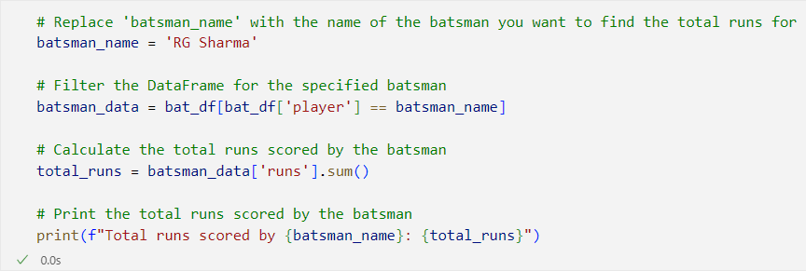


Slide 12
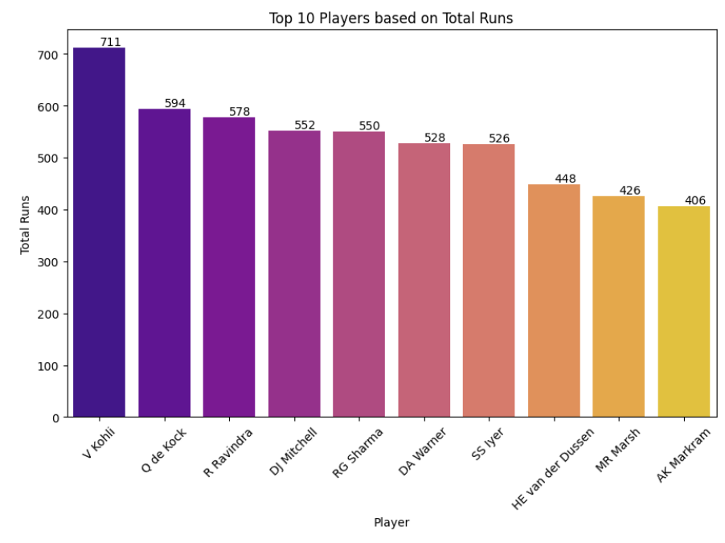
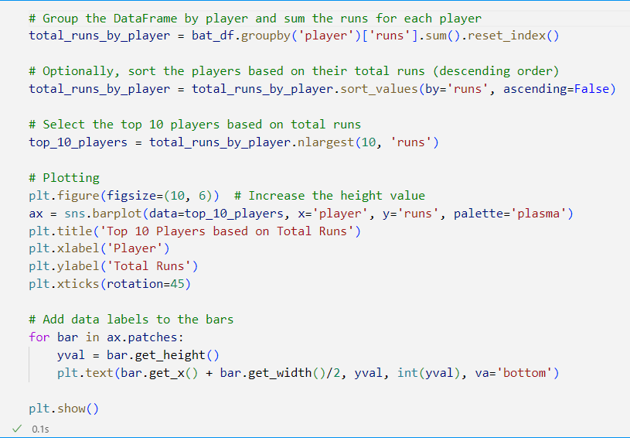

Slide 13
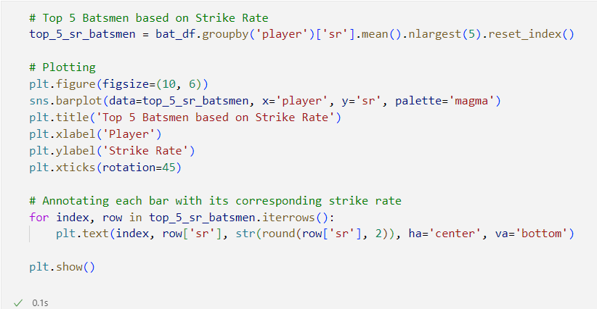
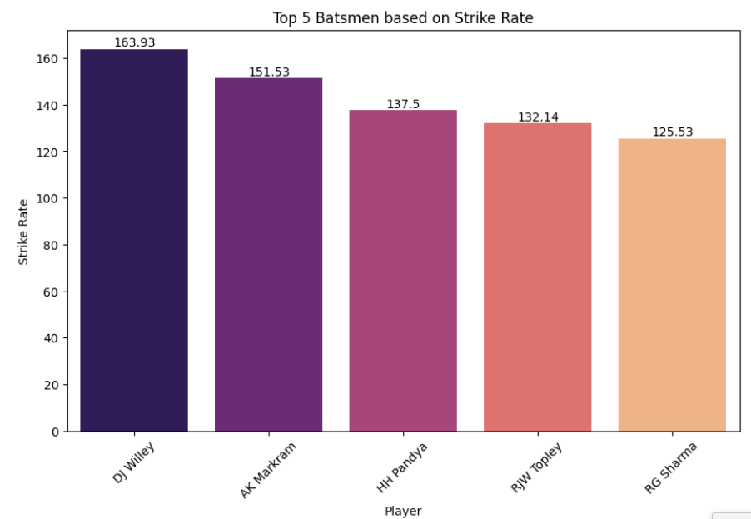

Slide 14
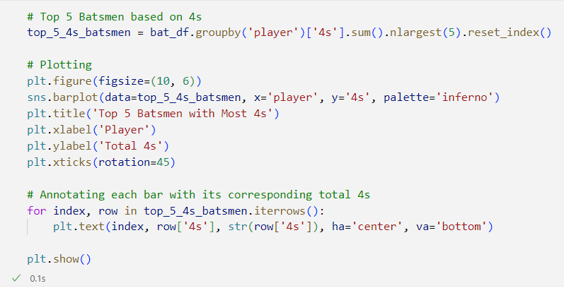
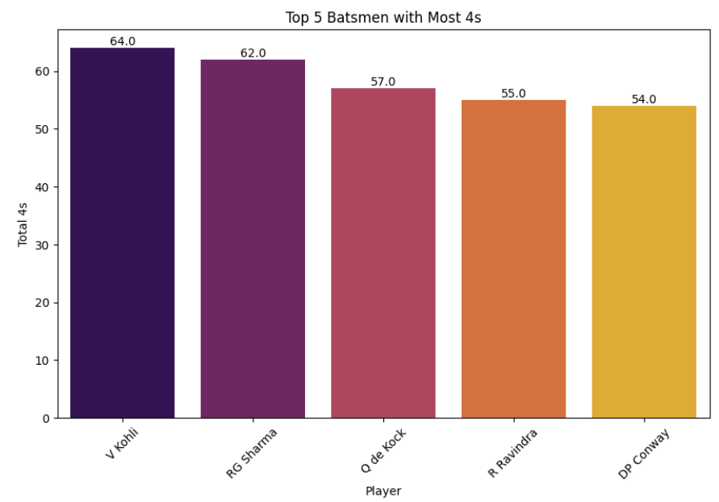
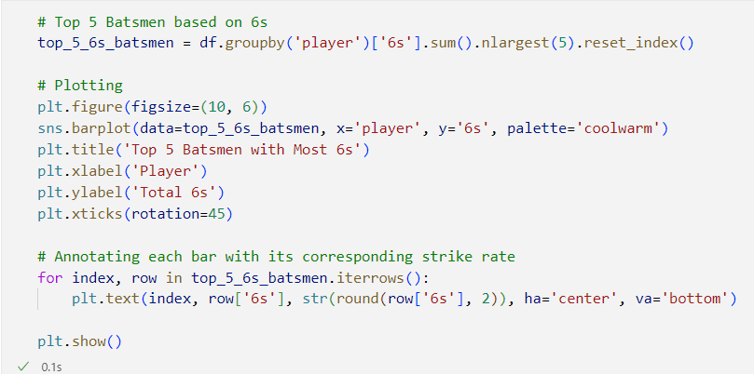
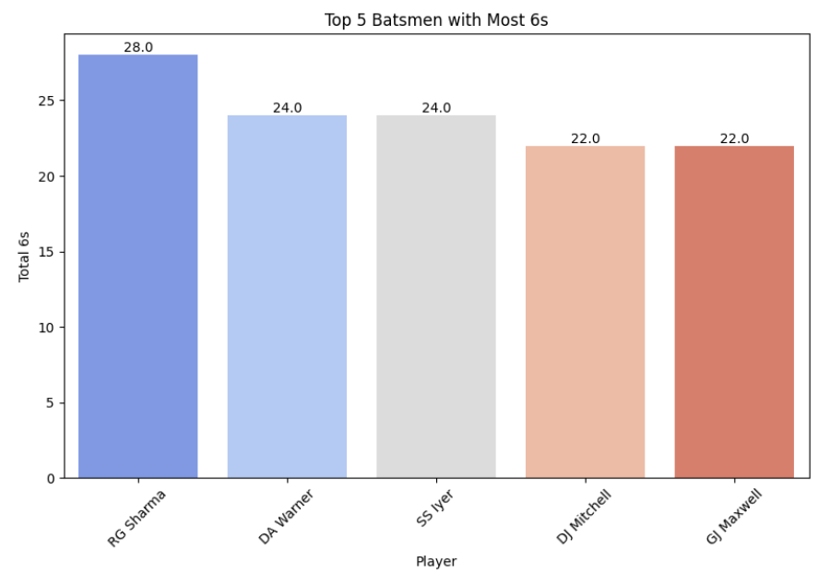

Slide 15
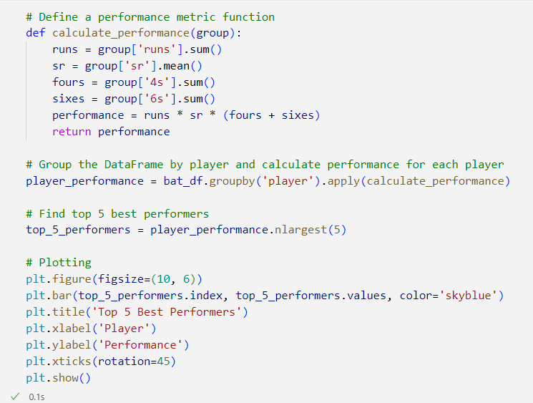
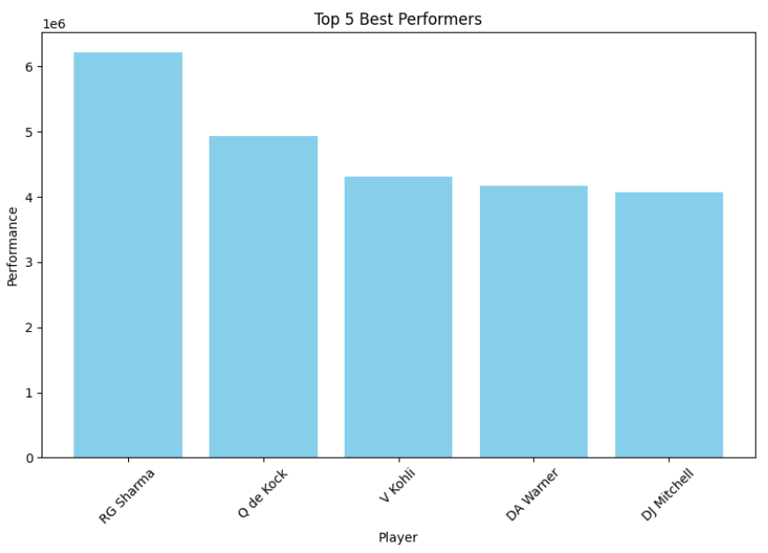

Slide 16

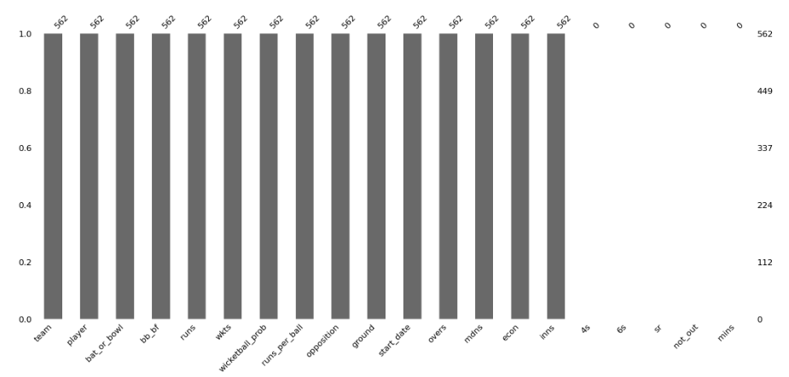

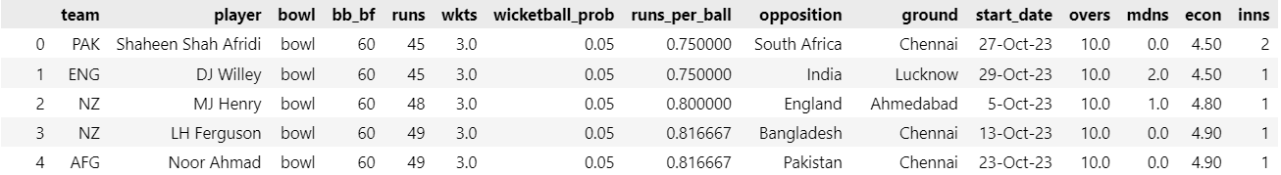
Bowling End

Slide 17
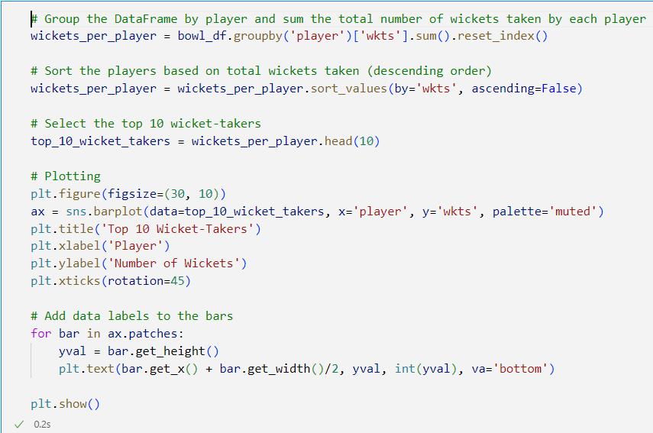
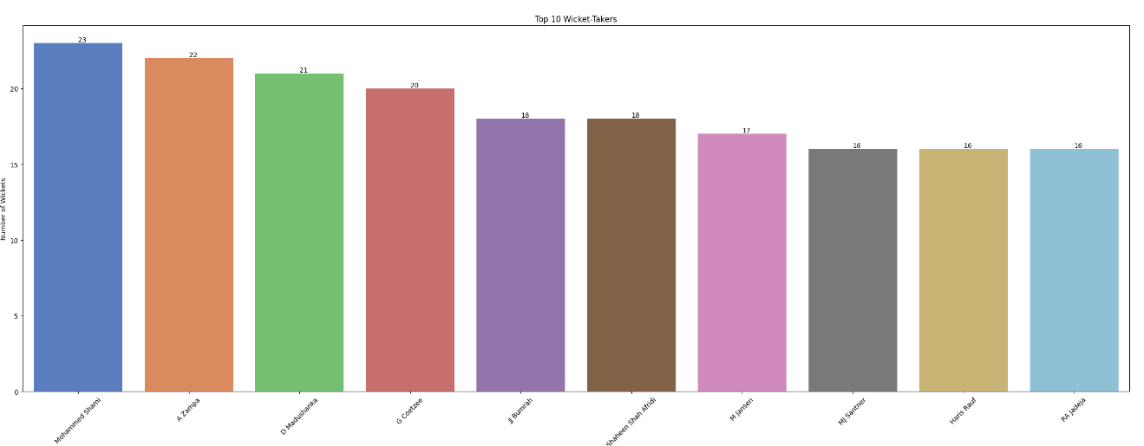
Bowling End

Slide 18
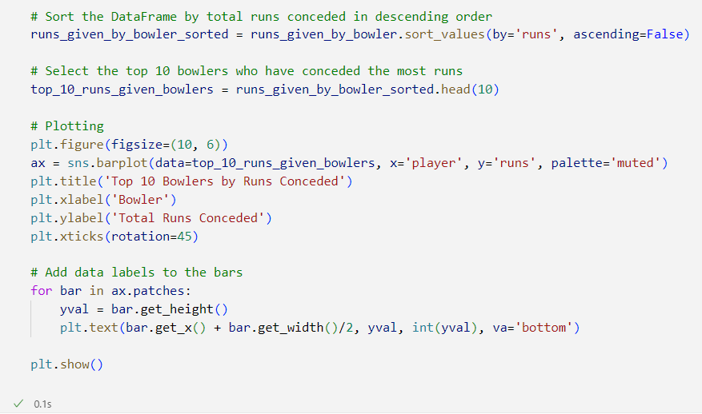
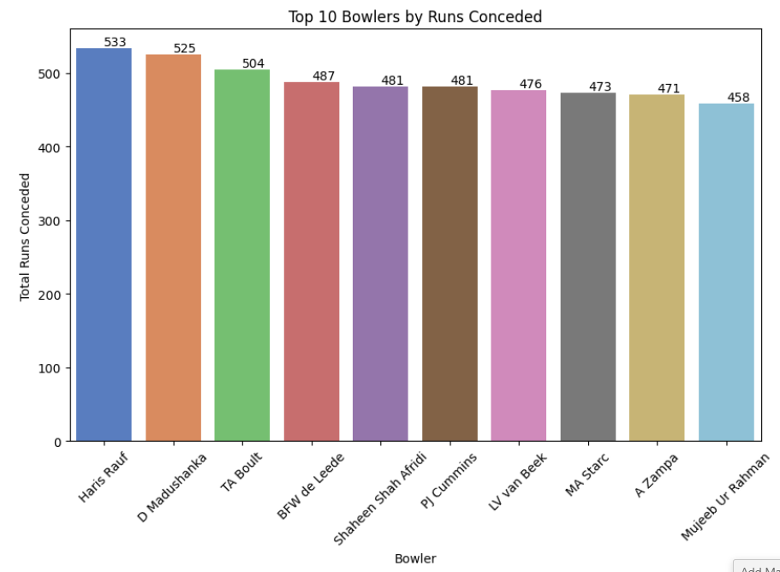
Bowling End

Slide 19
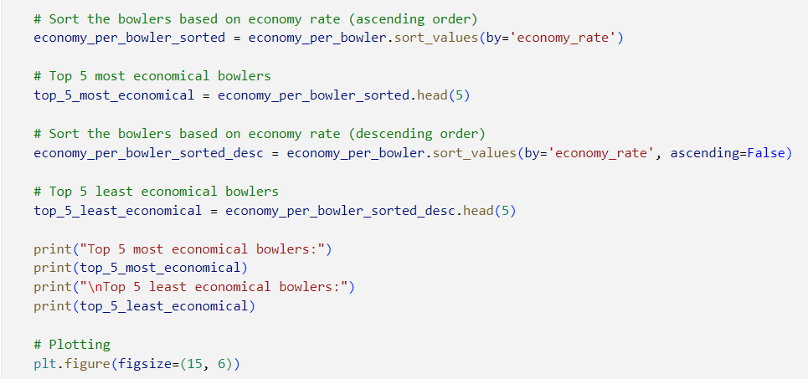
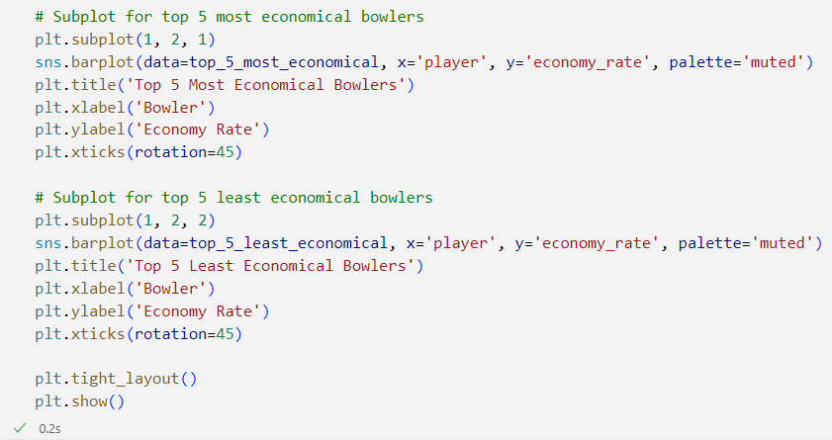
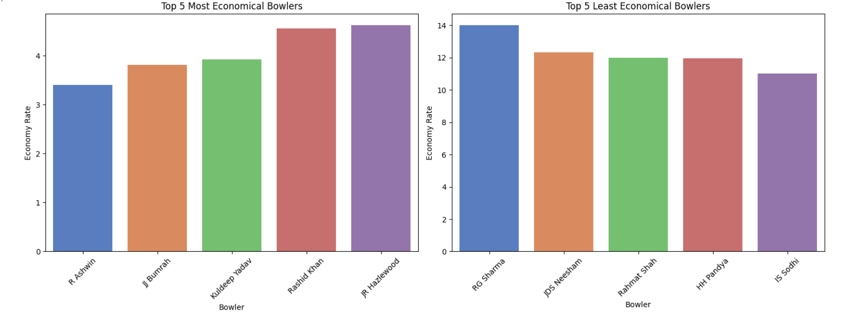
Bowling End

Slide 20
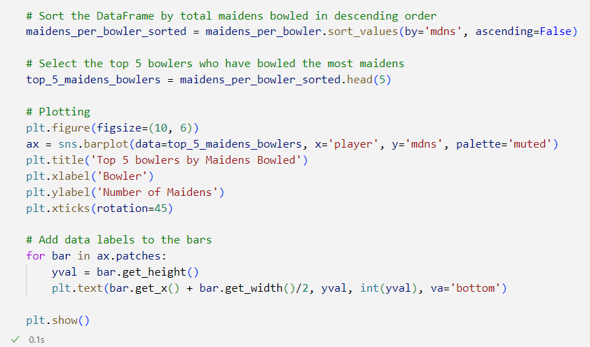
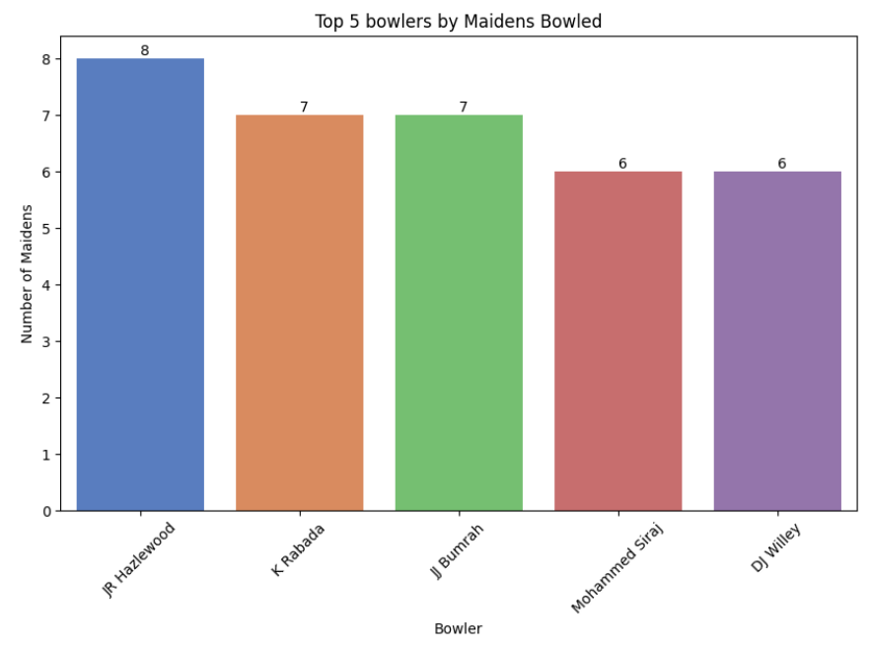
Bowling End

Slide 21
Bowling End

Slide 22
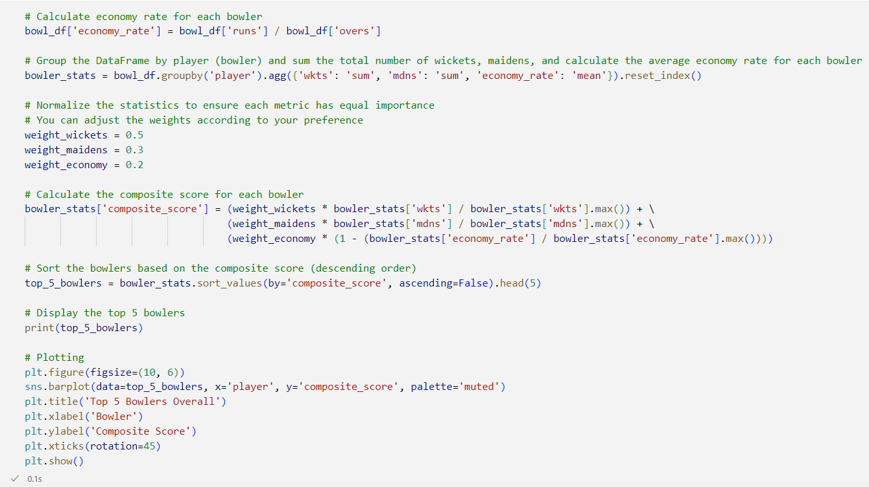
Bowling End

Slide 23
Bowling End

Slide 24
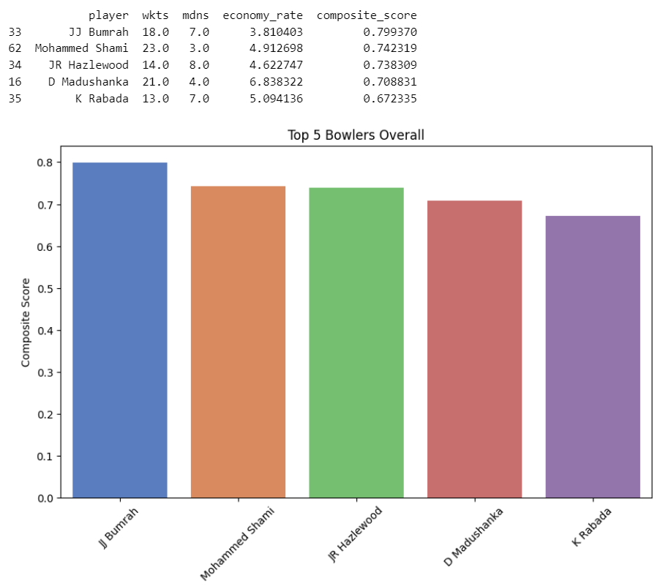
Bowling End

Slide 25
Bowling End
Conclusion
The analysis of the dataset reveals insights into the performances of bowlers, batsmen, and overall team dynamics, providing valuable information for strategic decision-making in cricket.

Slide 26
Thanks to All

